Slide 1
Making accessibility simpler in Higher Education and beyond!
Matthew Deeprose
University of Southampton
#TechSharePro22
Notes:
Hi everyone, I’m Matthew Deeprose from the University of Southampton. Welcome to this “Lunch and Learn” at TechShare Pro 2022 titled, “Making accessibility simpler in Higher Education and beyond!” I’m a white male, in my mid forties, wearing a pink shirt with a black jacket and matching pocket square. My pronouns are he/him.

Slide 2
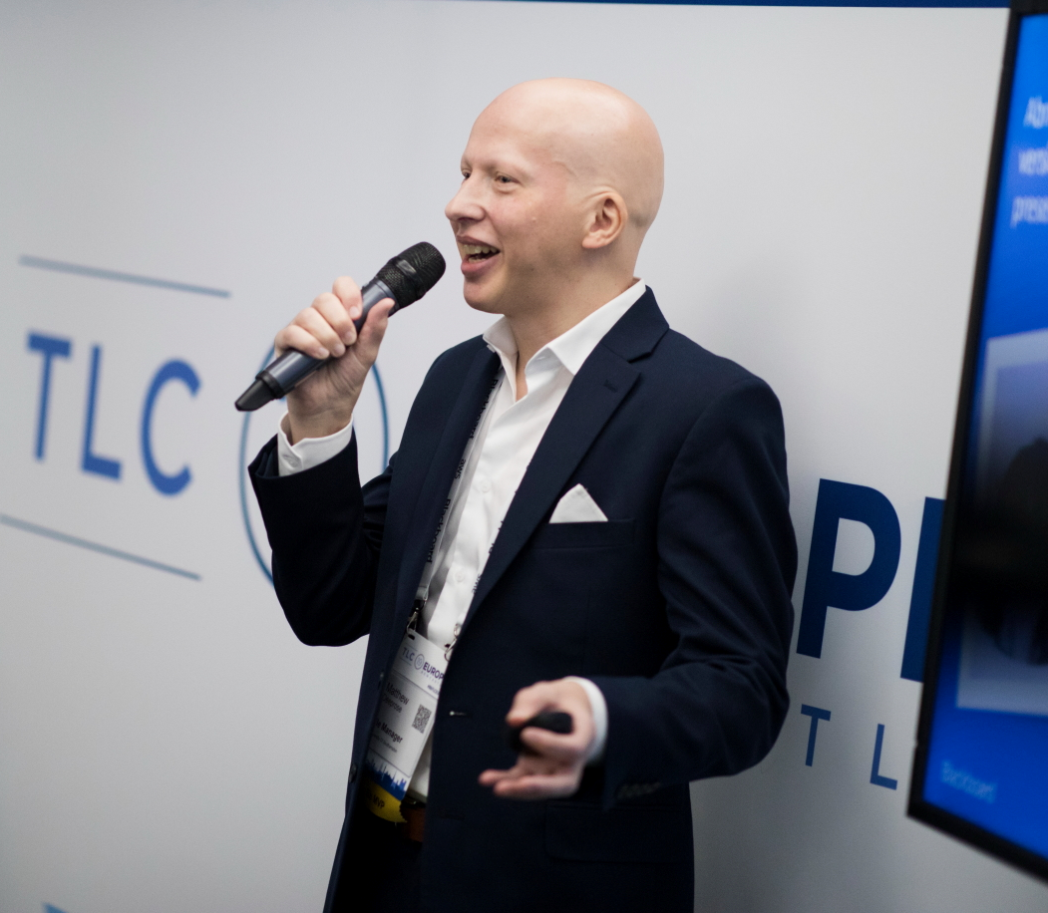
Who am I?
Matthew Deeprose
Senior Learning Designer
University of Southampton
matthewdeeprose.github.io
Notes:
I’ve been working in Higher Education IT for more than 20 years. Since I found out about The Public Sector Bodies Accessibility Regulations 2018, I’ve been learning about accessibility, finding opportunities to put it into practice and looking for ways to share what I learn with others.
Some recent accessibility projects I’ve been involved in have been:
refreshing our Virtual Learning Environment to have an updated, on brand theme that meets and surpasses accessibility guidelines as much as possible,
designing an Accessibility Testing process, running our Digital Accessibility Community of Practice, and designing and delivering accessibility focussed webinars.
We use Blackboard Ally and I’ve recently become co-chair of the European Blackboard Ally User Group. I’m also a member of the UCISA Diversity task force.
You can find out more about me and the work I’m doing on my website at matthew deeprose dot github dot i o
You can find my LinkedIn, Twitter, and YouTube there, feel very free to connect with me and give me feedback on this session.
Please use the slido to ask questions. You can also find a link in there to the dedicated captions from StreamText. You should also be able to pin Tim and Bridget our BSL interpreters. Alright! Let’s get started!

Slide 3

The challenge
Notes:
In my work, accessibility is about removing barriers that might prevent people from making the most out of our organisation’s digital estate.
In particular for those with disabilities, or impairments, be they permanent, situational, or temporary,
This is particularly important within the educational context, because Education has a significant impact on our lives.
Thinking in terms of removing barriers can sound quite simple.
But we will find complexity and puzzles to solve, first for our own understanding, and then for how we can explain and empower our colleagues to take action on removing those barriers.
For me, the key is finding a set of steps we can use to solve these puzzles.

Slide 4




How can we…
demystify alternative text for complex images like charts and graphs?
demystify alternative text for complex images like charts and graphs?
Sharing resources and techniques you can use immediately.
simplify accessible brand palette colour choices?
simplify accessible brand palette colour choices?
amplify engagement with accessibility?
amplify engagement with accessibility?
Notes:
So in this session, I’m going to use examples from my recent work to show how I’ve attempted to answer some of these questions.
[progress]
How can we…
demystify writing alternative text for complex images like charts and graphs?
[progress]
How can we…
simplify accessible brand palette colour choices?
[progress]
How can we…
amplify engagement with accessibility within our organisation?
[progress]
Since this is a lunch and learn session, I’ll be sharing links and resources, some of my own and some from others in the accessibility profession. You might have heard of some, but hopefully there will be something new and interesting for everyone and if they are useful, you can use them straight away.
I’m aiming to give you lots of resources, and at the end of my presentation I’ll do a quick fire run through of other resources I recommend that can help to demystify, simplify, and amplify.

Slide 5

For HE… and beyond!
Notes:
I’m speaking from my experience working in Higher Education Information Technology, but to a greater or lesser extent, everything I cover today is likely to be useful for any organisation.

Slide 6
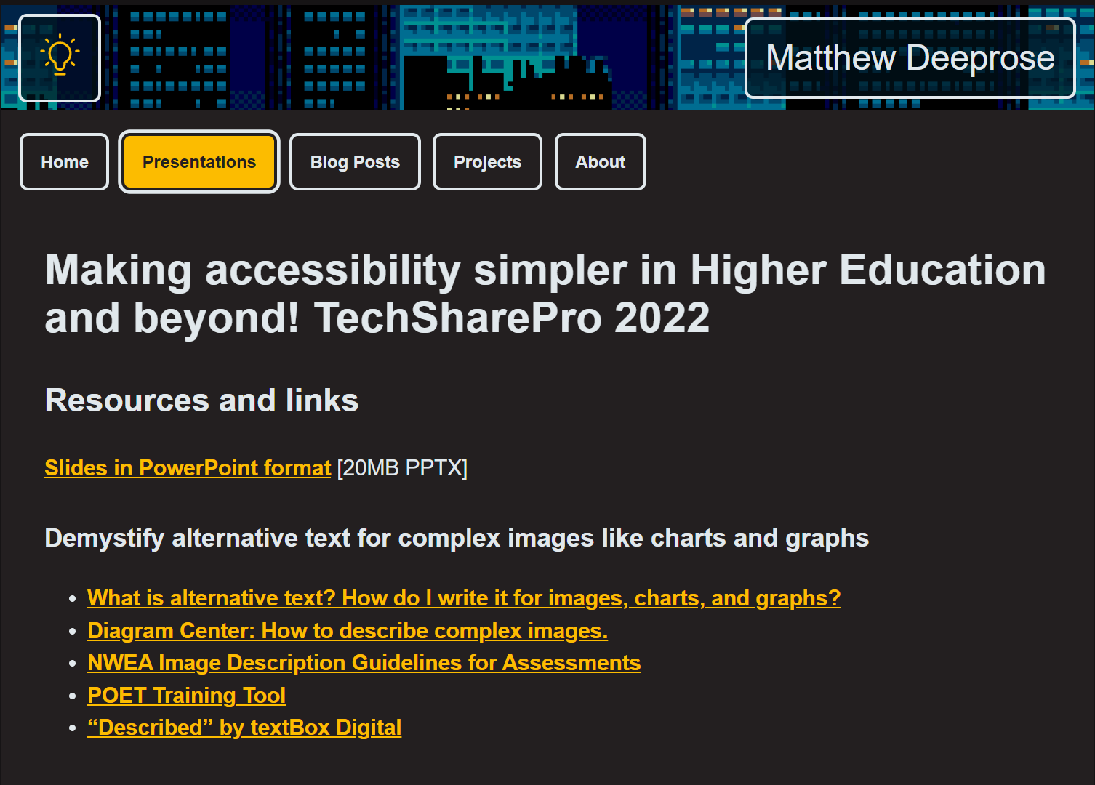
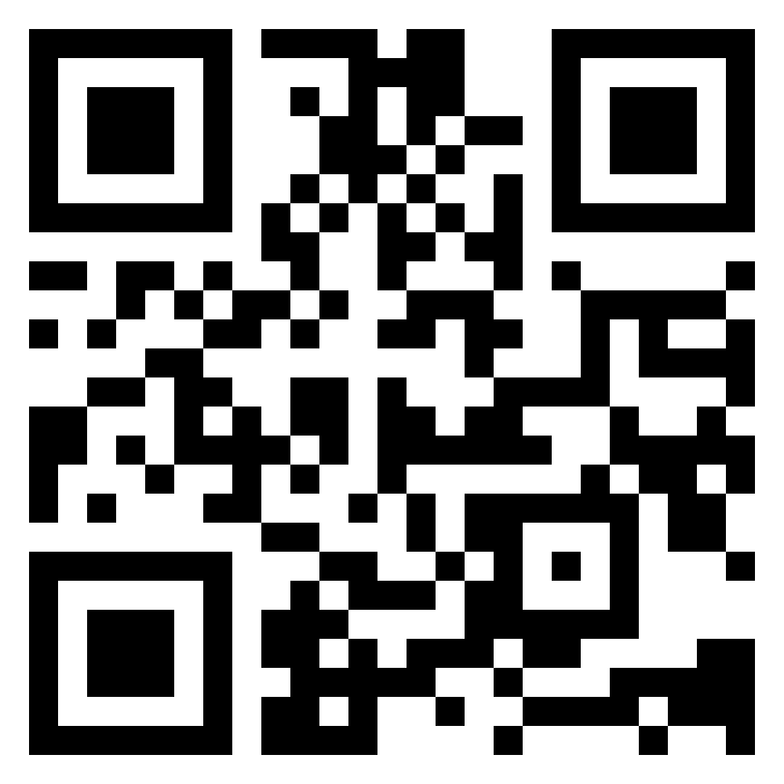
Presentation web page
https://go.soton.ac.uk/tsp
Notes:
The slide deck and all the resources I’ll be discussing are available from my presentation web page. You can reach it at this address:
go.soton.ac.uk/tsp
The link also appears in the footer of every slide.

Slide 7
How can we… 1
demystify alternative text for complex images like charts and graphs?
Notes:
First let’s look at writing alternative text for complex images like charts and graphs.

Slide 8
Alternative text
One of the top issues affecting accessibility of learning content
Existing guidance can be overly simple
Good alt text realises potential of the audio alternative formats
Notes:
Missing or poorly composed alternative text is one of the top accessibility issues affecting learning content at my University. It’s also the second most common accessibility issue that the Web Accessibility in Mind (WebAIM) organisation found in their survey of the million most popular web pages.
While there’s lots of good examples out there, often a quick google search will return fairly basic guides that use quite simple images as examples. It can be more difficult to find advice around the more complex images we use in education and elsewhere.
Writing good alternative text is really important. Many Universities use systems such as Blackboard Ally or Sensus Access that provide students with alternative formats, such as an audio version. Good quality alternative text really helps students to get the most out of alternative formats.

Slide 9
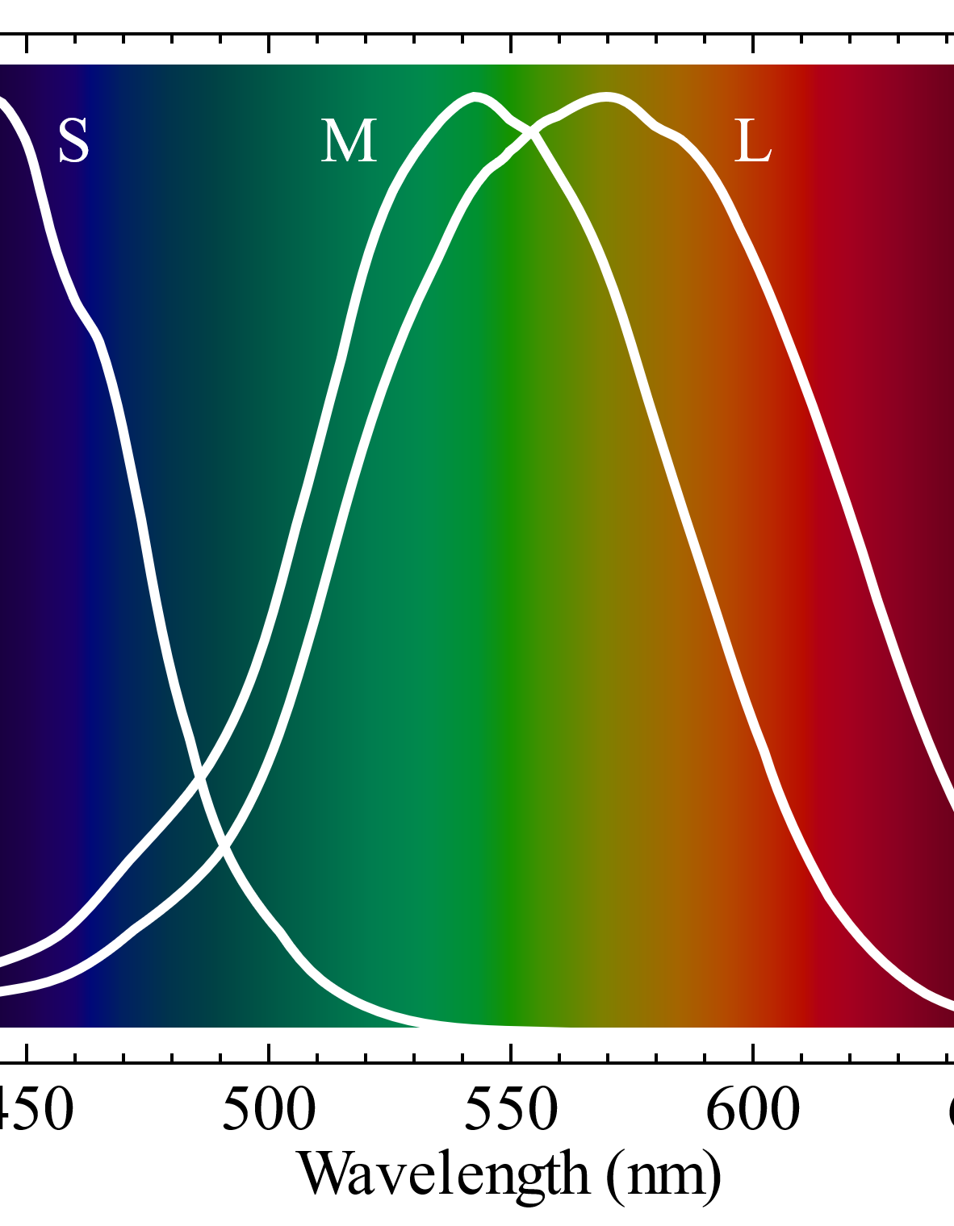
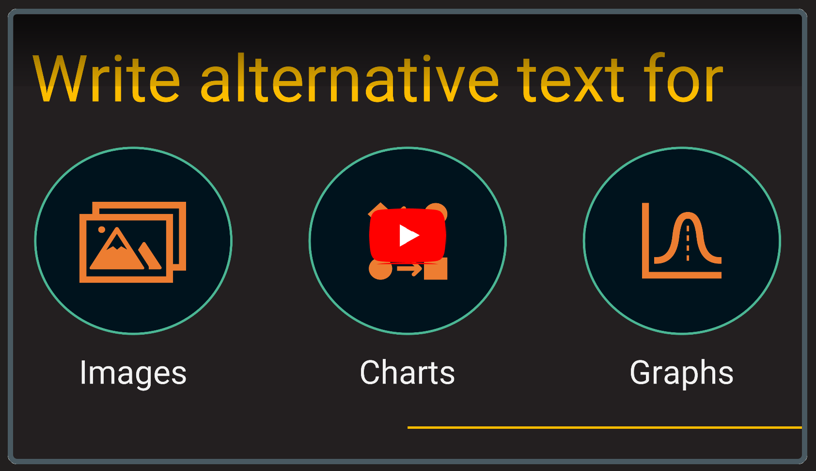

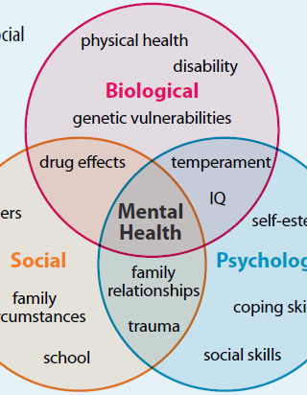
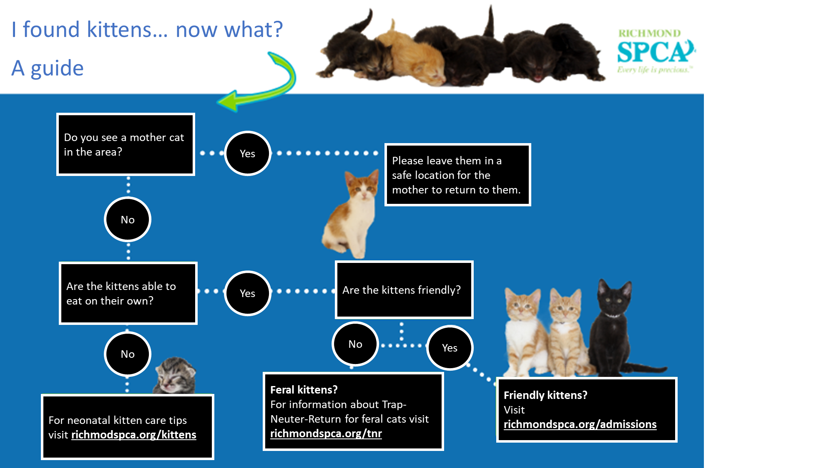


Alt text for images, charts, and graphs
Thirty minute session.
Six worked examples
Resources
Notes:
We recently designed and ran a thirty minute session about writing alternative text for images, charts and graphs.
[progress]
We covered six examples, from basic images to more complex ones like graphs, decision trees, and Venn diagrams.
[progress]
Rather than go into detail about the session, because you can review the recording, slides and materials on line in your own time, I want to highlight which resources were really useful for me in creating the session.

Slide 10
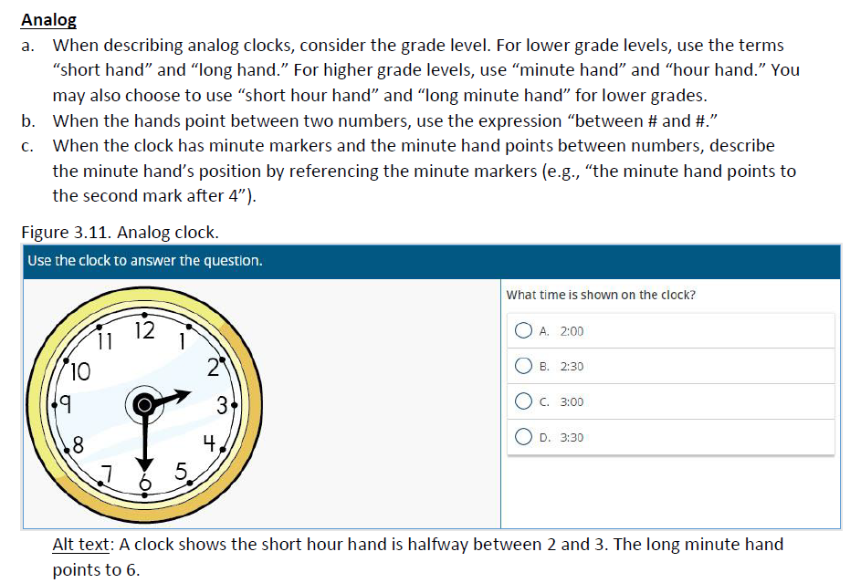
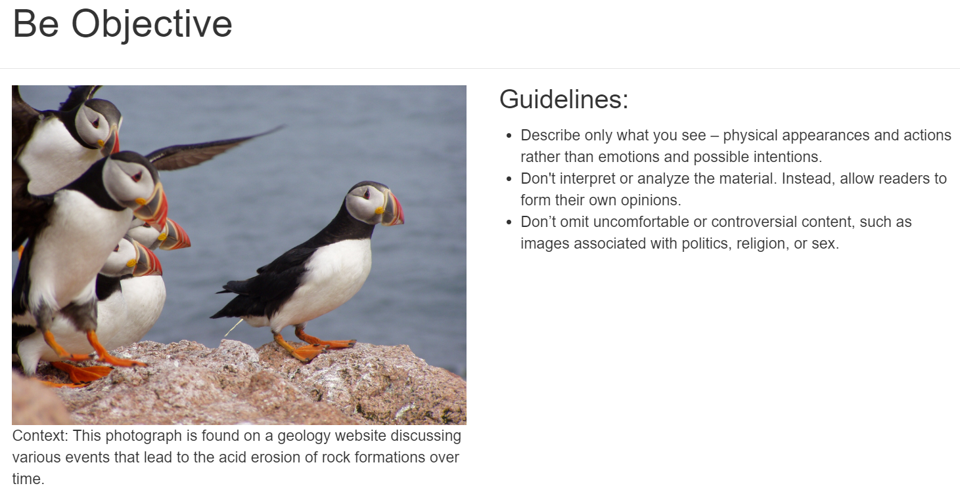
Key resources 2
POET Training Tool
Diagram Center: How to describe complex images.
NWEA Image Description Guidelines for Assessments
Notes:
Diagram Centre have a really good YouTube video on describing complex images. It’s quite old now, but they get through a lot of different image types.
The Northwest Evaluation Association, NWEA has produced an incredible resource on writing alternative text for images that are used in assessments. How can you describe an image without giving away the answer? This is an incredible resource if you write quizzes or assessments.
Many of you will be aware of the POET Training Tool that has exercises you can follow to learn more about writing alternative text. If you’ve not come across it before I highly recommend it.

Slide 11
“Described” by textBox Digital
A bank of techniques for describing various types of complex image.
A commercial service with a cost.
Advert
Artwork
Diagram
Film
Graph
Icon
Music
Illustration
List
Logo
Map
Music
Photograph
Scientific
Screenshot
Sign
Symbol
Text
Notes:
The previous resources were all freely available. This next resource is amazing but has a cost, from £400 a year for access for three users.
textBox digital’s “described” service provides guidance and worked examples of writing alternative text for different types of image.
On screen I’m listing the types of image they cover, examples include Diagrams, graphs, Illustrations, Maps, and scientific images such as circuit diagrams.

Slide 12
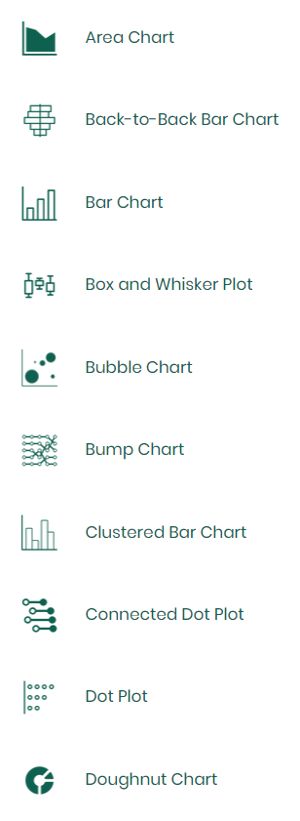
“Described” by textBox Digital 2
A bank of techniques for describing various types of complex image.
A commercial service with a cost.
Notes:
I’m now sharing a list of examples from the graph section. This includes area charts, box and whisker plots and dot plots.

Slide 13
For each type of image
Guidance
Process
Example
Description
Notes:
When you select an image type, Described provides an overall set of guidance, a step by step process, and a worked example with final complete description. Once you have a process you can follow it really helps you to unlock what once might have been a mystery and can make it seem simple.

Slide 14
Description strategies
Context
Descriptions of the same image will vary depending on the context.
Audience
Who is your target reader?
Function
What is the purpose of the image?
When images are more complex
Title
Construction of image
Summary or overview
Data
Notes:
Some high level strategies for all descriptions are to consider the context in which we use the image, our intended audience, and the function or purpose of that image. You might write different descriptions for the same image as the context, audience, and function changes.
[progress]
For more complex images, a full description should include the Title, the Construction of image, a Summary or overview, and a data table if relevant.

Slide 15

Demystified?
Notes:
So even if you have some really complex images you need to describe. There’s lots of resources out there that can help you. Of course, even with a structured process, you still need the subject matter expertise once you get to writing the descriptions.

Slide 16
How can we… 2
simplify accessible brand palette colour choices?
Notes:
Next I’m going to speak to the question of how we can simplify making accessible colour choices.

Slide 17

Accessible, on-brand colour choices
Notes:
Insufficient colour contrast is the most prevalent issue reported in the WebAIM million. It’s something that’s so easy to get right, but you have to know about it.

Slide 18
Contrast in WCAG
3:1
7:1
(not to scale)
Minimum for Text
AA
AAA
Minimum for Graphical Objects / UI
4.5:1
Enhanced level for Text
1.4.11 Non-text Contrast (Level AA)
1.4.3 Contrast (Minimum) (Level AA)
1.4.6 Contrast (Enhanced) (Level AAA):
2.4.11 Focus Appearance (Minimum)
2.4.12 Focus Appearance (Enhanced)
Notes:
The web content accessibility guidelines state that a contrast ratio of 3:1 is the minimum level of contrast for graphical objects like icons.
[progress]
A contrast level of 4.5:1 is the minimum for text
[progress]
7:1 and higher is the minimum for text when we want to reach the AAA level of accessibility.
For someone new to accessibility, this can seem a bit intimidating, if someone just wants to use our brand colour palette, how can they make accessible choices easily?

Slide 19
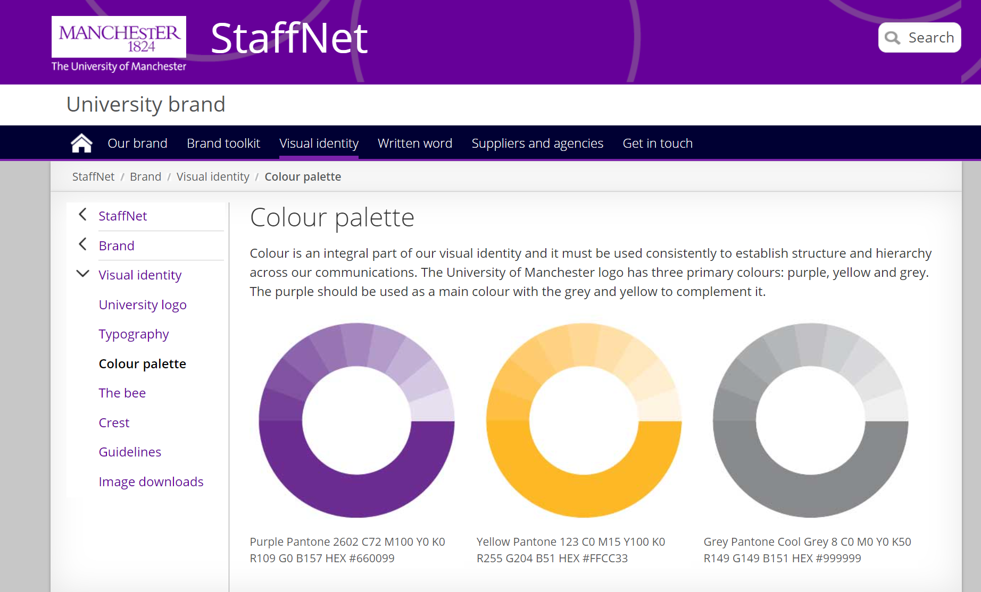
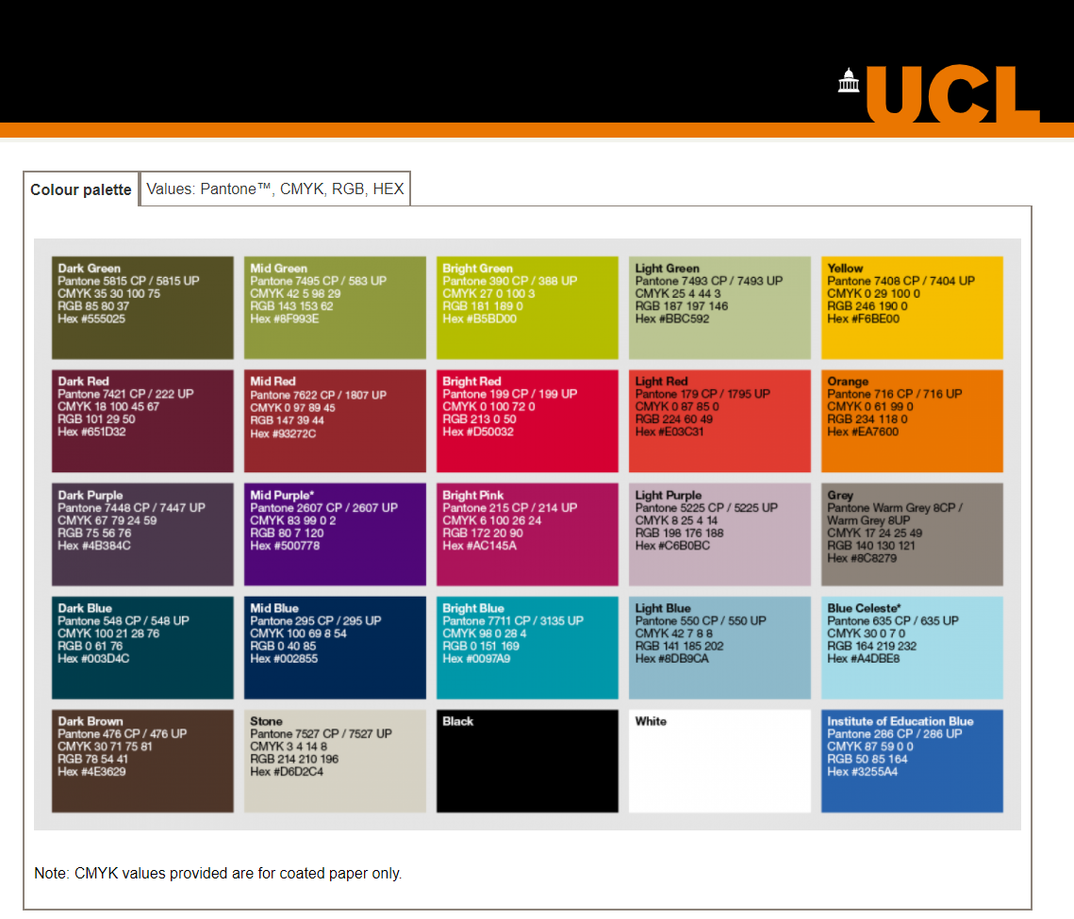
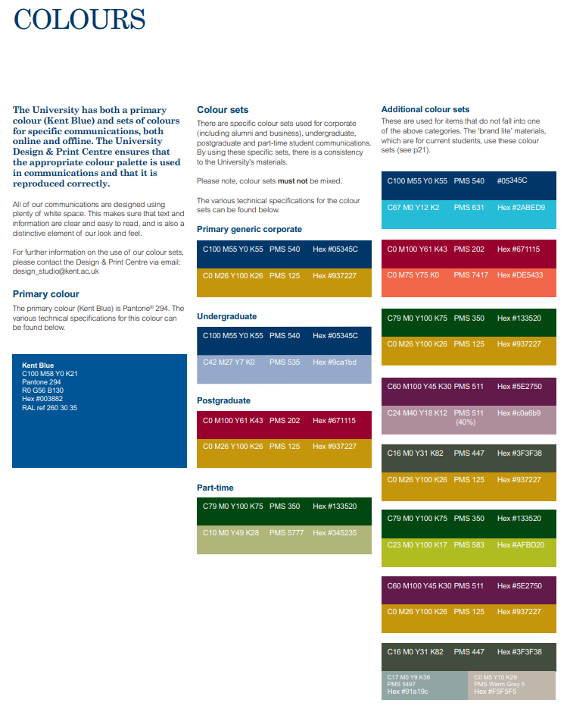
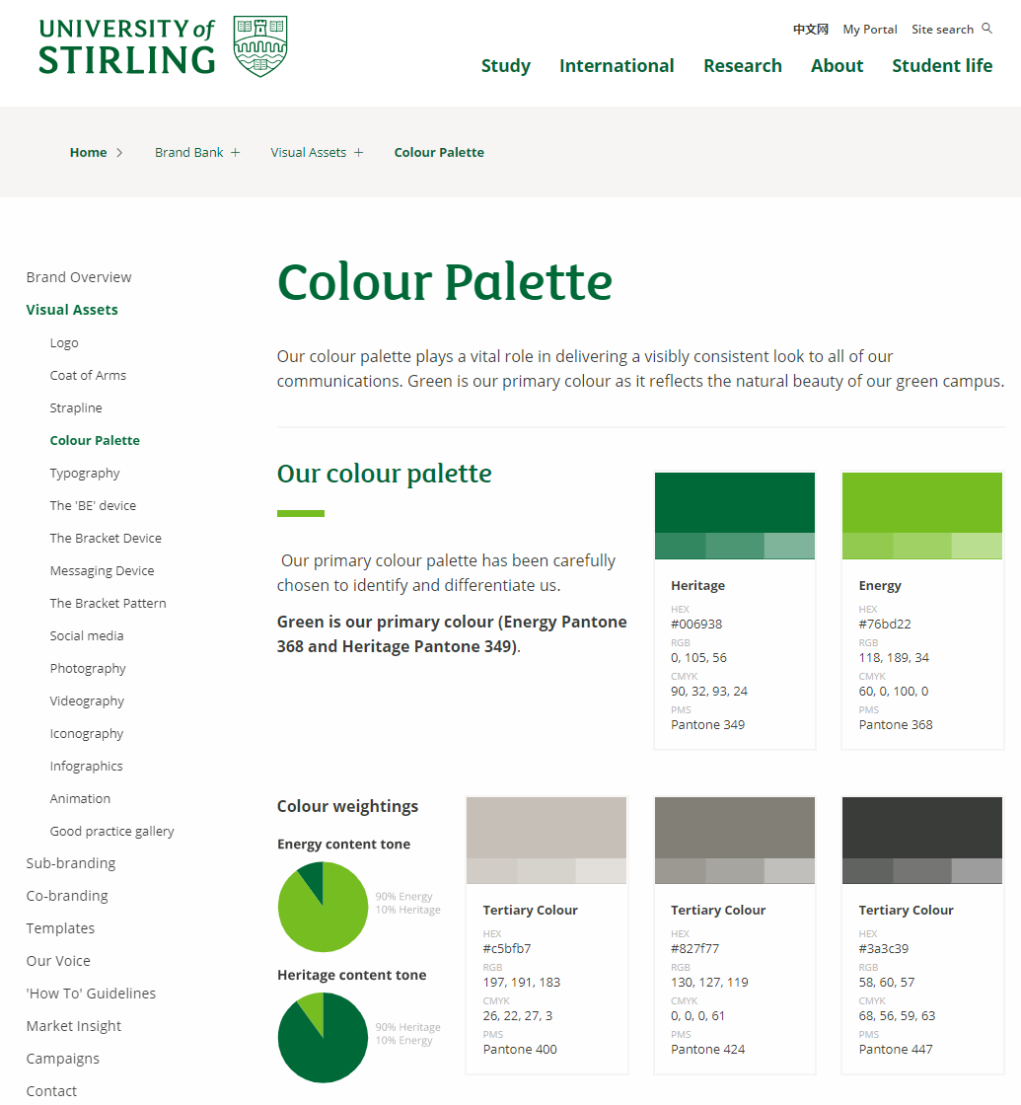
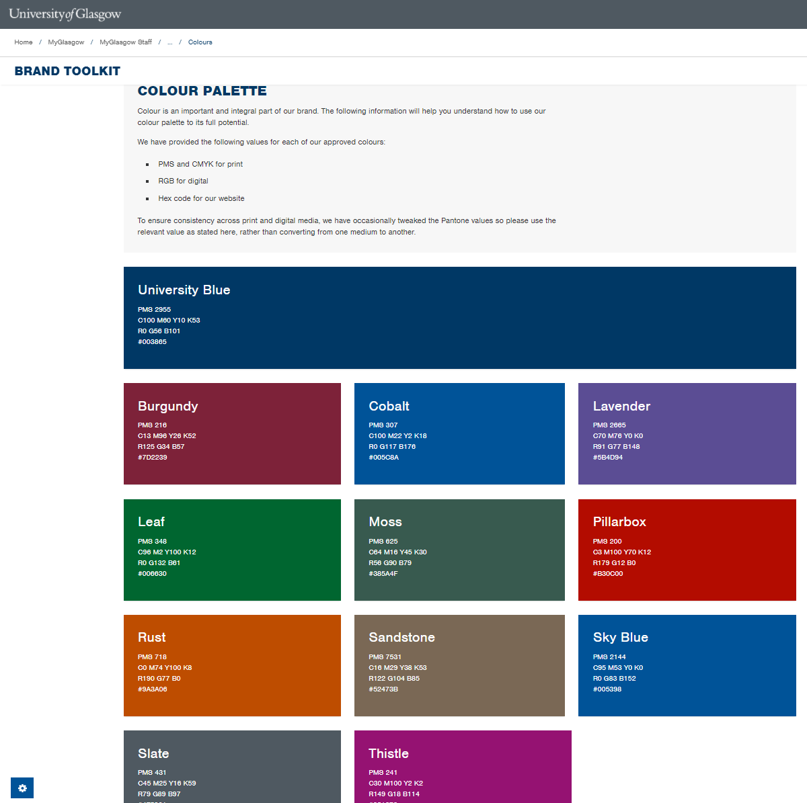
Using brand colour palettes
Notes:
Most organisations including Universities, have corporate colour schemes, aligned with their brand.
They are likely to be part of powerpoint and word templates with brand colours included in the theme. Websites and online applications are likely to use the brand colours, not only for content, but for the whole user interface, including hover states, focus indicators and so on.
Heather from SkyScanner was speaking yesterday about they work they had done to create a new brand colour palette that was more accessible.

Slide 20
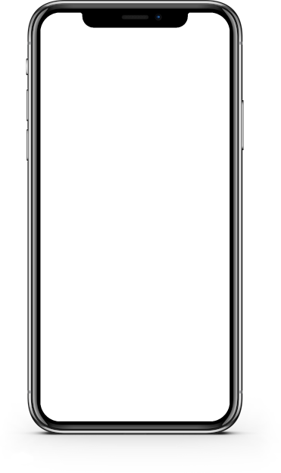

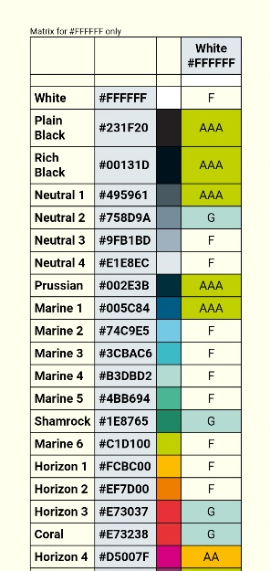
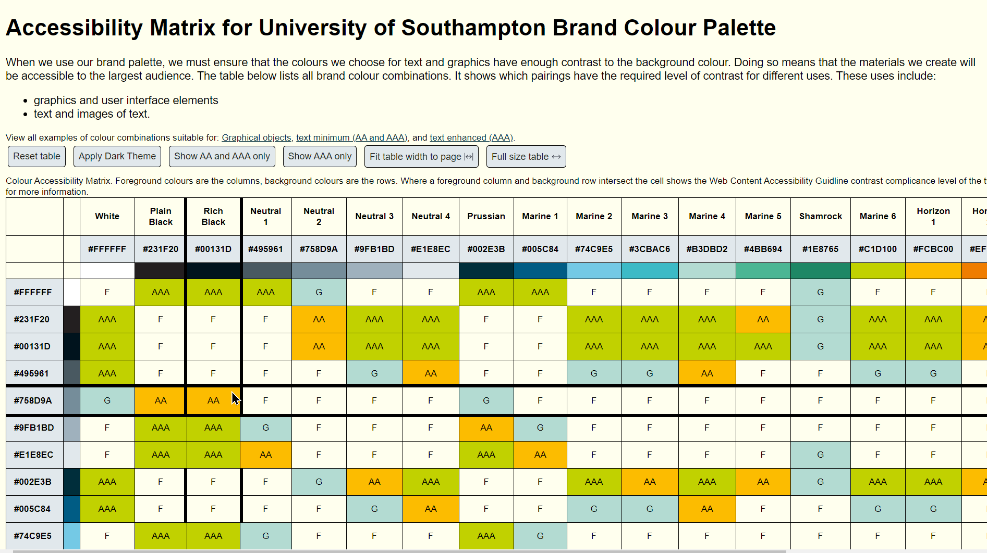
Brand colour matrix
Notes:
When I was redesigning the colour theme for our virtual learning environment I was frequently looking up the contrast ratios of colours from our brand. To save me time I built a look up table with all 441 possible colour combinations. Overtime I turned this into a web page.

Slide 21
Example
Notes:
To zoom in and give you a clear understanding. The same colours are in the same order for both the horizontal and vertical axes. Where two colours meet the table shows F, if it fails all contrast criteria. G means it can only be used for graphical objects, AA means that as well as graphical objects it can be used for text, but only at the minimum AA level, and AAA means it can be used for text at the enhanced level, as well as for graphical objects.

Slide 22
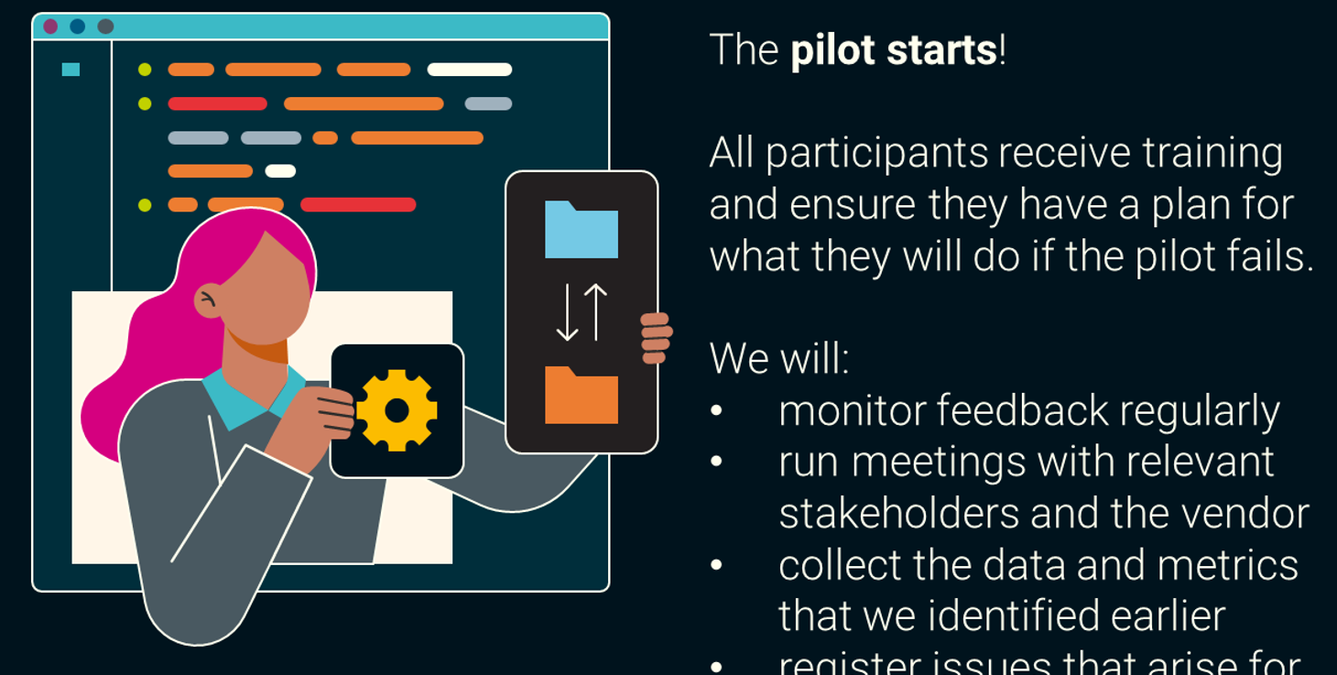
Example 1
Notes:
To give you one example of how I’ve used this colour matrix. The past couple of months I’ve been creating some infographics. To make them more visually interesting I’ve been using vector based stock images such as this one on screen which is a slightly abstract illustration of a computer screen with a woman holding a settings symbol and a file transfer symbol.
[progress]
To make these images more congruent, I recolour them using my University’s brand, and the matrix helps me to pick colours that have sufficient contrast with each other. This is an small part of an infographic I’m producing that explains our pilot process for new Educational Technology tools.

Slide 23

Requesting a matrix
Notes:
Since I wrote a script to create the colour matrix, I can feed it with the colours of any brand, so if it would be useful for you there’s info on my presentation web page about how to request one for your brand.

Slide 24
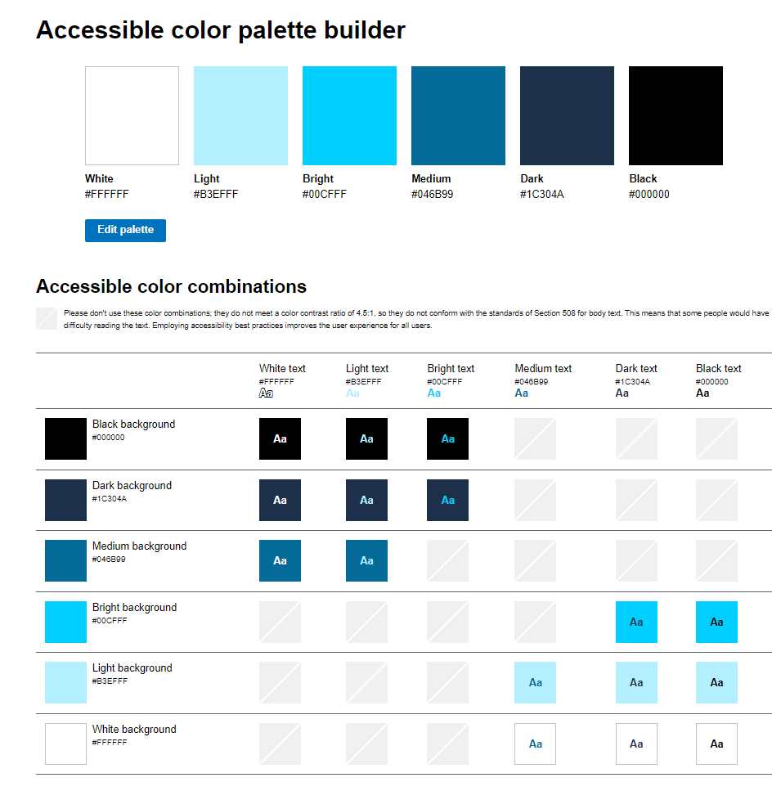
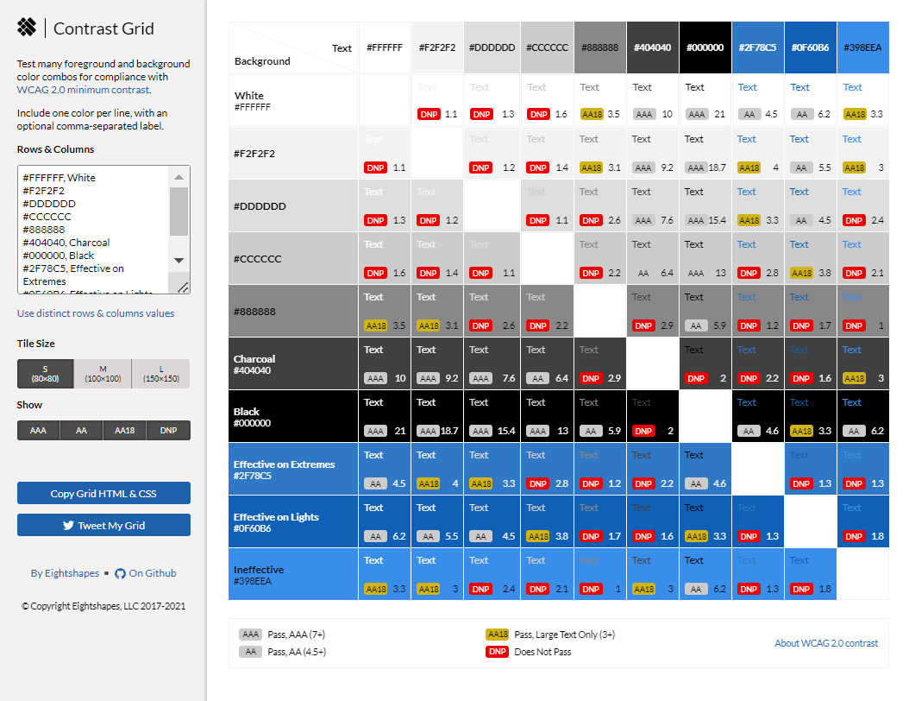
Related tools
Notes:
A few months after making the script, I found others had the same idea and have similar tools online.
Onscreen is the accessibile colour palette builder, and a tool called Contrast Grid, that offer very similar functionality.
Note that while I’ve tested my own content for accessibility, I haven’t tested the third party sites that I’ll be sharing in this presentation.
I’ve got links on the support site to both of these tools, I’m going to give you a quick demo of Contrast Grid.
https://contrast-grid.eightshapes.com
List of colours for demo: FFFFFF,White
231F20,Plain Black
00131D,Rich Black
495961,Neutral 1
758D9A,Neutral 2
9FB1BD,Neutral 3
E1E8EC,Neutral 4
002E3B,Prussian
005C84,Marine 1
74C9E5,Marine 2
3CBAC6,Marine 3
B3DBD2,Marine 4
4BB694,Marine 5
1E8765,Shamrock
C1D100,Marine 6
FCBC00,Horizon 1
EF7D00,Horizon 2
E73037,Horizon 3
E73238,Coral
D5007F,Horizon 4
8D3970,Horizon 5

Slide 25
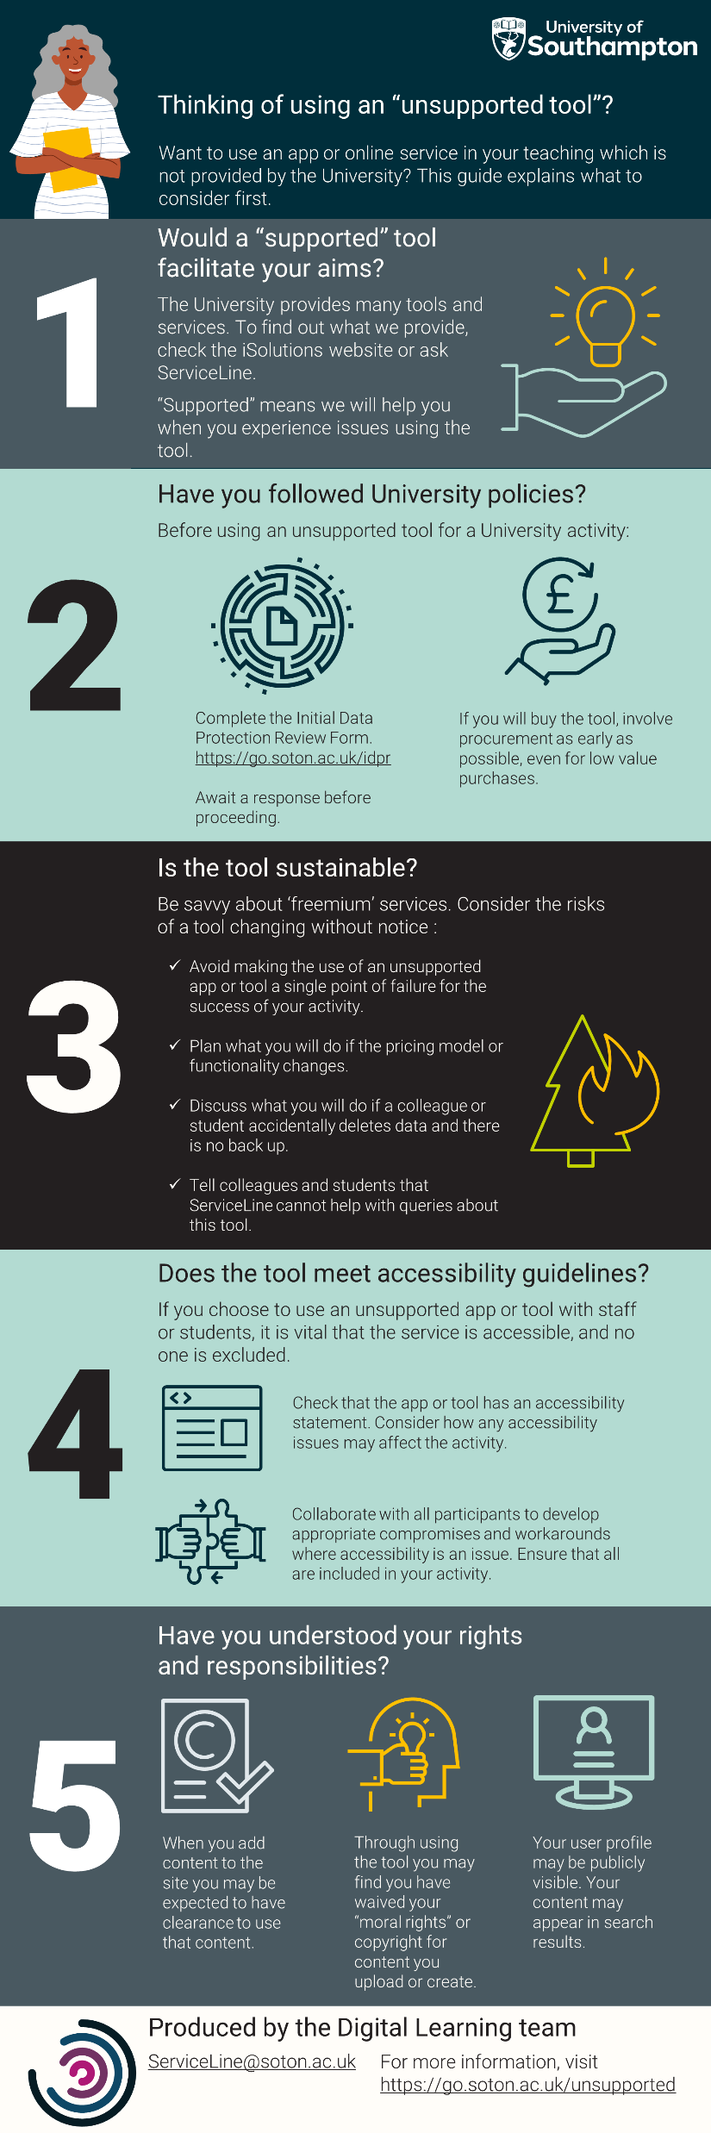
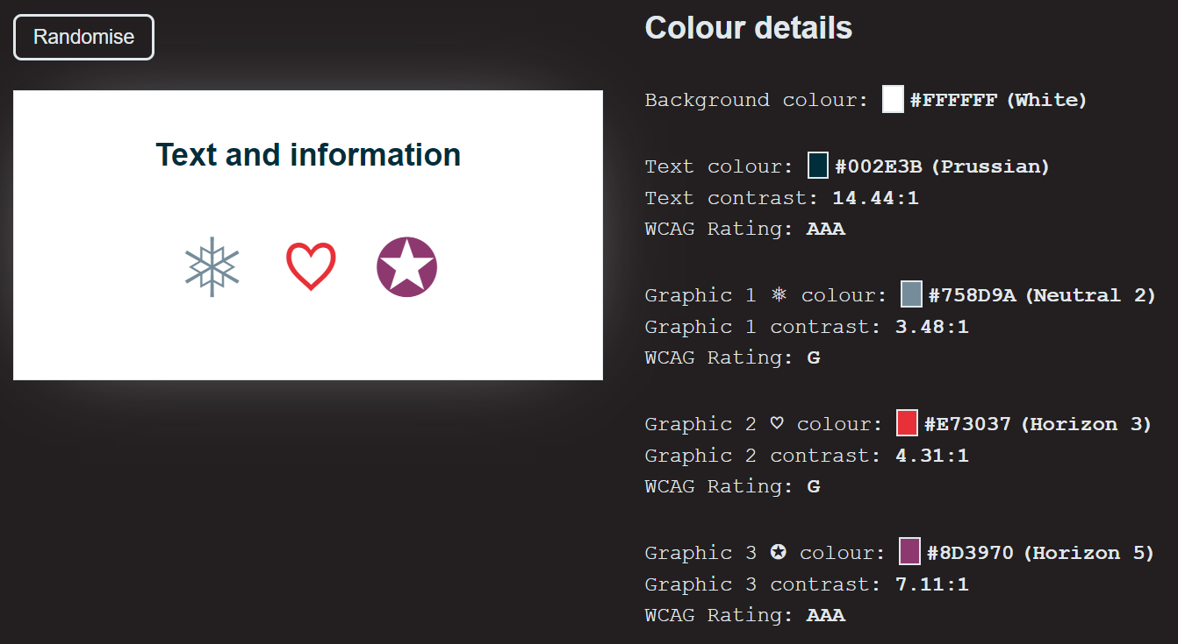
Inspiring curiosity?
Notes:
The colour matrix might still be a bit too intimidating for some. I’m always looking for approaches to invite curiosity with accessibility and make it more approachable.
[progress]
A couple of months ago I was working on another infographic and a colleague mentioned he hadn’t seen one of the colours combinations I used before.
[progress]
I had an idea for a colour randomiser, that would offer an accessible colour combination from our brand. It gives one background colour, one text colour, and three colours for graphical objects.
I’m going to give you a quick demo.

Slide 26
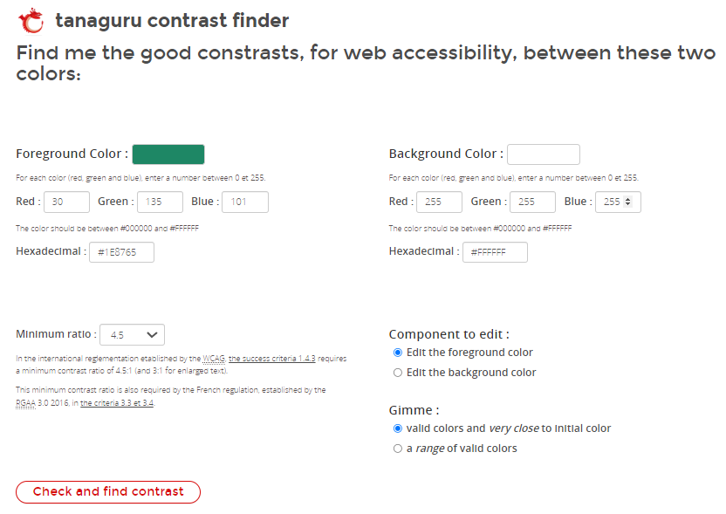
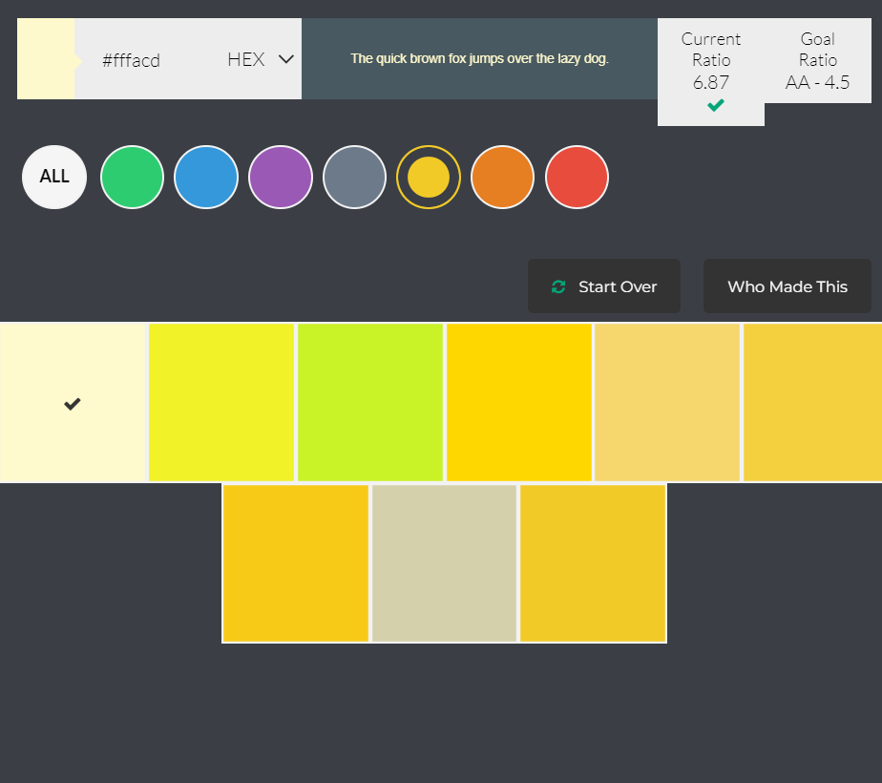
More contrast tools
Notes:
There are other useful tools out there. You may find yourself wanting to use a colour combination that does not have enough contrast, how can you find a colour that is a close match which does have sufficient contrast.
On screen I have screen shots of two tools that can help you with this, the Tanaguru Contrast Finder, and Colour Safe. I’m going to show you the Tanaguru Contrast Finder:
https://contrast-finder.tanaguru.com/result.html?foreground=%231E8765&background=%23FFFFFF&ratio=4.5&isBackgroundTested=false&algo=Rgb&distanceSort=asc

Slide 27
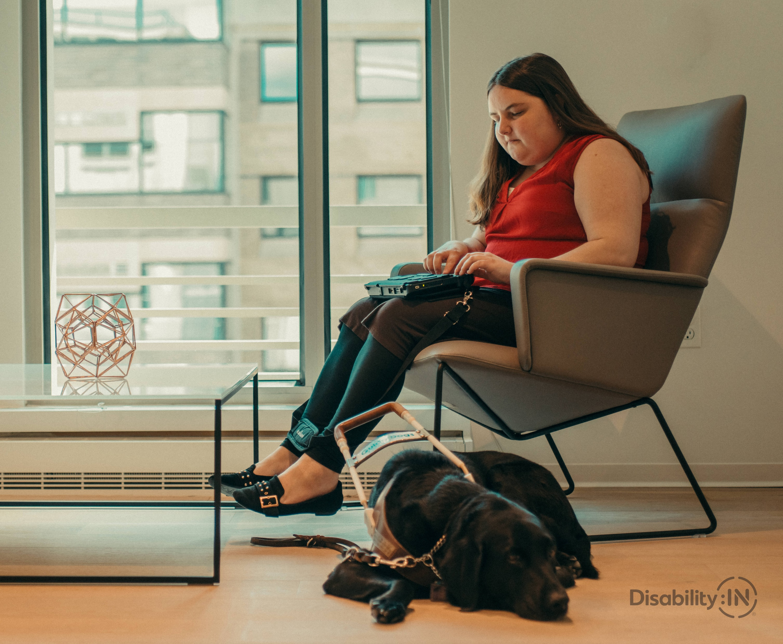
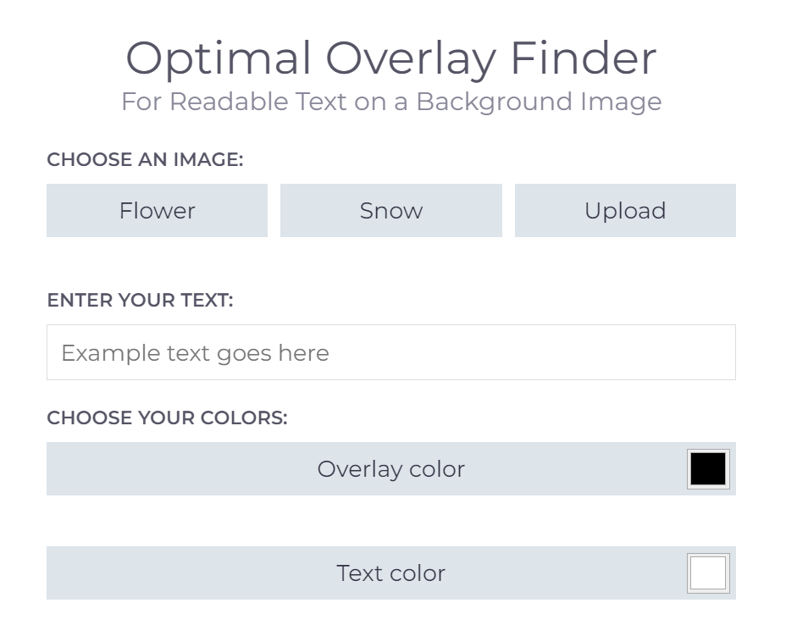
Text over photographs
When everyone is included, everyone wins.
CC BY-ND 4.0 - Disability:IN
Notes:
Another aspect of accessible contrast is when we add text over images. In this example we have a quote from Jesse Jackson, “When everyone is included, everyone wins”, in white text over a photograph of a woman using a refreshable braille display sat beside her service dog. The white text is very difficult to read because the photograph has a lot of light colours.
There are different strategies to resolving this, we could use a black outline around the text, or drop shadow, or just put a solid colour behind the text, or we could add a layer over the photo that darkens it, helping to make the text more legible.
[progress]
The Optimal Overlay Finder is tool I often use and recommend to colleagues. Let’s take a look at it.
Disability Inclusive Stock Photography from Disability:IN
Quote from Jesse Jackson

Slide 28
How can we… 3
amplify engagement with accessibility?
Notes:
My final question is how can we amplify engagement with accessibility across our organisation?

Slide 29

Organisational changes to benefit accessibility
Notes:
I’m going to share one small change that I believe has done just that. You’re probably aware of the accessibility inspector in Office. It appears in Word, PowerPoint and Excel.

Slide 30
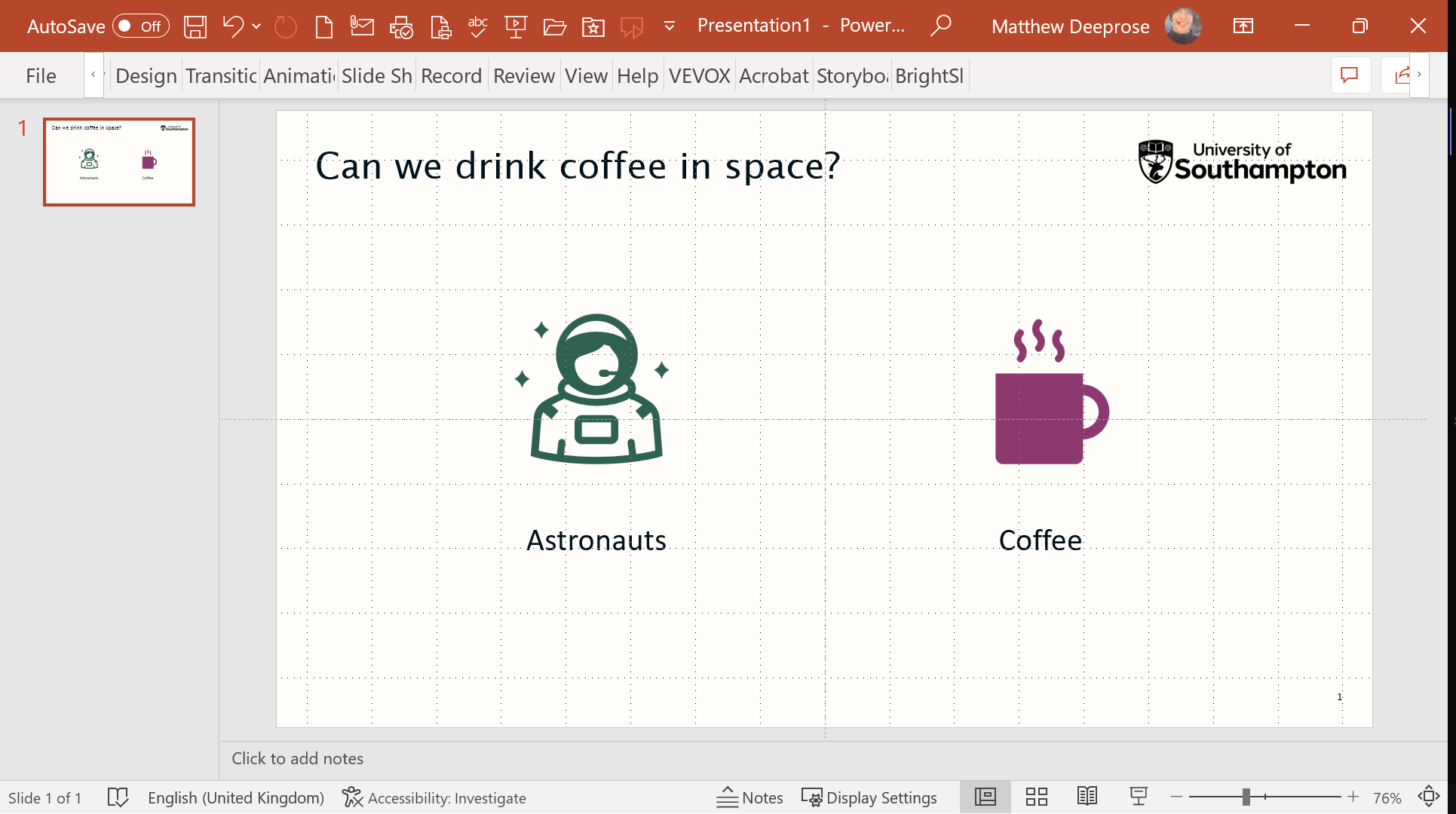

Accessibility inspector
16 accessibility issues checked while you work.
Each user must turn it on, in each of Word, PowerPoint and Excel.
Notes:
You’re probably already using it. It can check for 16 different accessibility issues whilst you work.
When it finds accessibility issues an “Accessibility: Investigate” alert appears. Selecting it gives you an overview of the issues and steps you can follow to improve accessibility, for example setting the reading order, using headings, resolving contrast issues, adding headings to tables and so on.

Slide 31
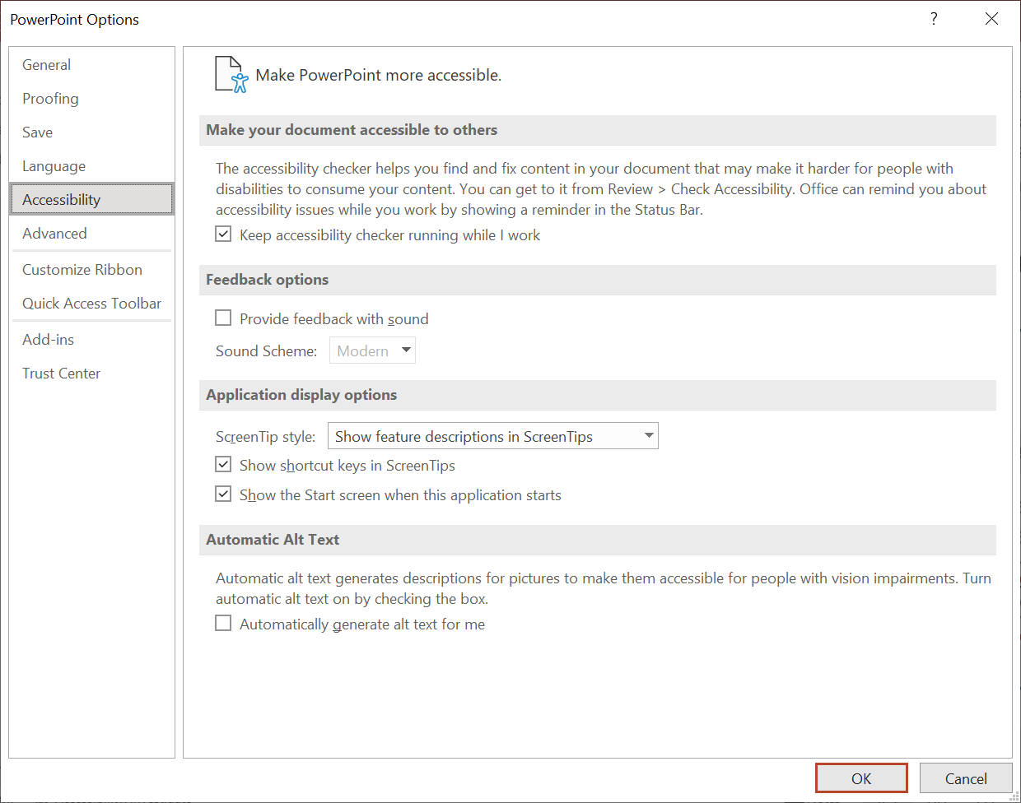
Turning on “check while I work”
Notes:
But to benefit from this feature, each user has to turn on the “keep accessibility checker running while I work” option for each of Word, PowerPoint, and Excel in the settings.

Slide 32
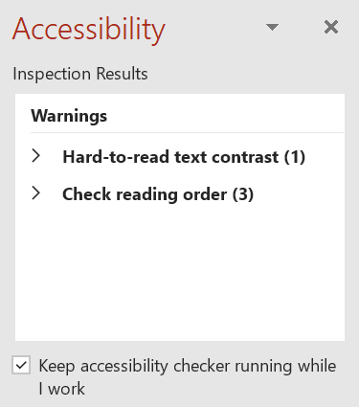
Turning on “check while I work” 2
Notes:
An alternative method is that after running an accessibility check in one of Word, PowerPoint, or Excel you can select a check box within the inspection results panel to “keep accessibility checker running while I work”.

Slide 33

What if…?
Notes:
What if we could remove those steps?
Like many organisations, our University sets up PCs for staff and students.
Could we just turn on this feature? I checked with the brilliant Microsoft enterprise disability answer desk, who said it was possible using an admin tool called Group Policy. They didn’t give me a step by step, but just knowing it was possible meant I could follow up with our Desktop team who put this into action for us.

Slide 34

Removing friction
Implementation plan: Turn on “keep accessibility checker running while I work”
Training webinar: “Better content, made easy”
Notes:
We’ve now implemented the change so that the accessibility inspector is always running while our staff and students work on University machines. I’ve also shared an anonymised implementation plan that other organisations can use to make the same change on their PCs, and I’ve shared a webinar recording, slides, and materials for how we explained and demonstrated the benefits of using the accessibility inspector.

Slide 35
Inviting curiosity
What happens if I select this button?
Conversation starter
Templates
“Good to go”
Notes:
We only made this change a couple of months ago. Since we’re quite used to Microsoft Office changing quite frequently now we’re on Microsoft 365, I’m hoping that lots of our colleagues will be curious to select the button and review how they can make their content more accessible.
We’ve already been approached by a senior governance group led at executive level who asked for help to make their Word templates more accessible after they noticed the results of the accessibility inspector.
It’s also proved an interesting conversation starter. In a world of hybrid meetings we often see when people share their screens the accessibility status of their documents. Some have been sharing their tips on how they approached resolving an accessibility issue they found whilst producing content.
I also really like how when the accessibility inspector cannot find any issues, the button changes to “accessibility good to go”, we made this one of the key messages in our training, that a resource isn’t “good to go” until the accessibility inspector says it is “good to go”.

Slide 36
How can we… Conclusion
demystify alternative text for complex images like charts and graphs?
demystify alternative text for complex images like charts and graphs?
Sharing resources and techniques you can use immediately.
simplify accessible brand palette colour choices?
simplify accessible brand palette colour choices?
amplify engagement with accessibility?
amplify engagement with accessibility?
Notes:
So far I’ve shared some of my experiences with demystifying how we write alternative text, simplifying the accessible use of brand colour schemes, and amplifying engagement with accessibility. Hopefully some of the resources were new or interesting to you and on the presentation web site you can find all the links.

Slide 37

Quick fire round!
Notes:
Just in case you didn’t find any of what we covered so far of interest, I’m doing a quick fire round, sharing more resources that can help to simplify your accessibility journey.

Slide 38
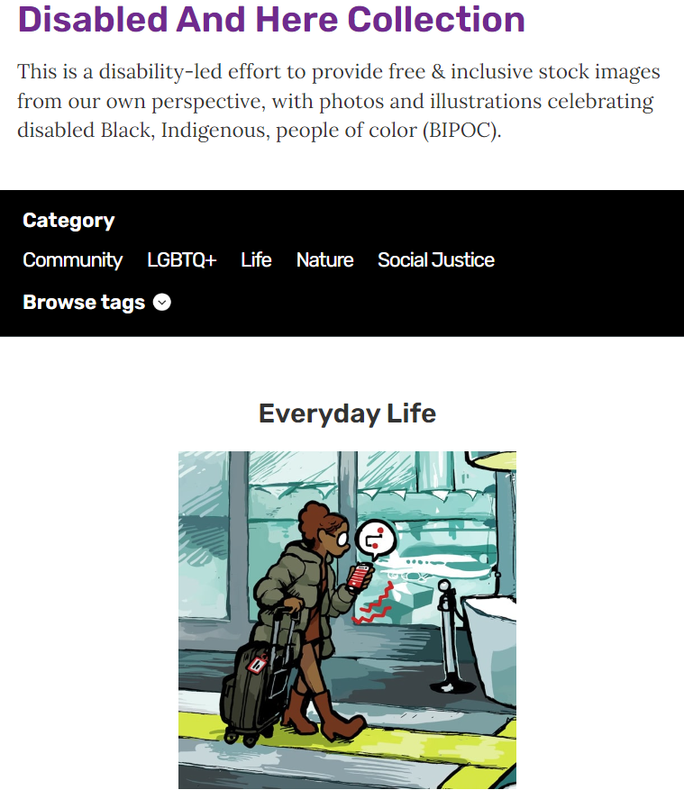

Stock photography
Notes:
I’m often using stock photo services, and when I look for more inclusive imagery I’m not sure about how credible some of the images are. I remember a really interesting presentation from Keely-Cat Wales and Dan Edge of C Talent, Dan mentioned that you could tell in some images whether a wheelchair was just being used as a prop.
Both the Disabled and Here Collection and the Disability:In inclusive stock photo library are available on creative commons.

Slide 39

Introducing accessibility
Notes:
If you’re looking for a way to introduce people to digital accessibility, the Accessibility Maze is an web-based game that you and your colleagues can play to learn more about accessibility
It was created to help those new to web accessibility experience first hand what it is like to encounter accessibility barriers. The game introduces a number of common barriers players must work around, mirroring the experience of those who encounter these obstacles daily, and provides quick lessons on how to avoid or correct them.

Slide 40
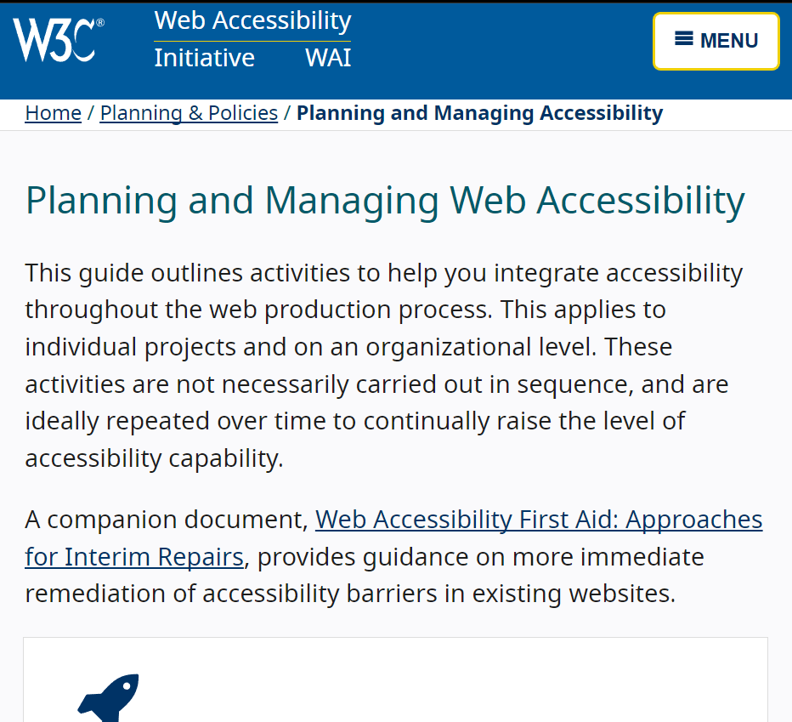
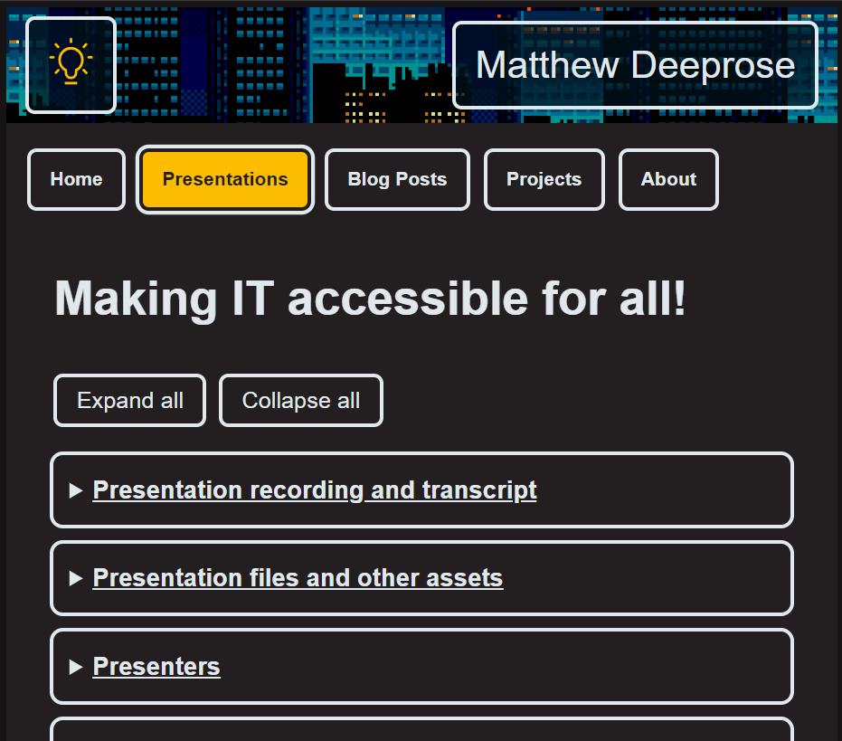
Organisational implementation
Notes:
If you’re looking for tips on how to approach implementing accessibility within an organisation, the W3C has a fantastic pathway “Planning and Managing Web Accessibility”, some colleagues and I gave a session last year showing how to apply this in an educational context at an event called “Making IT accessible for all!”

Slide 41
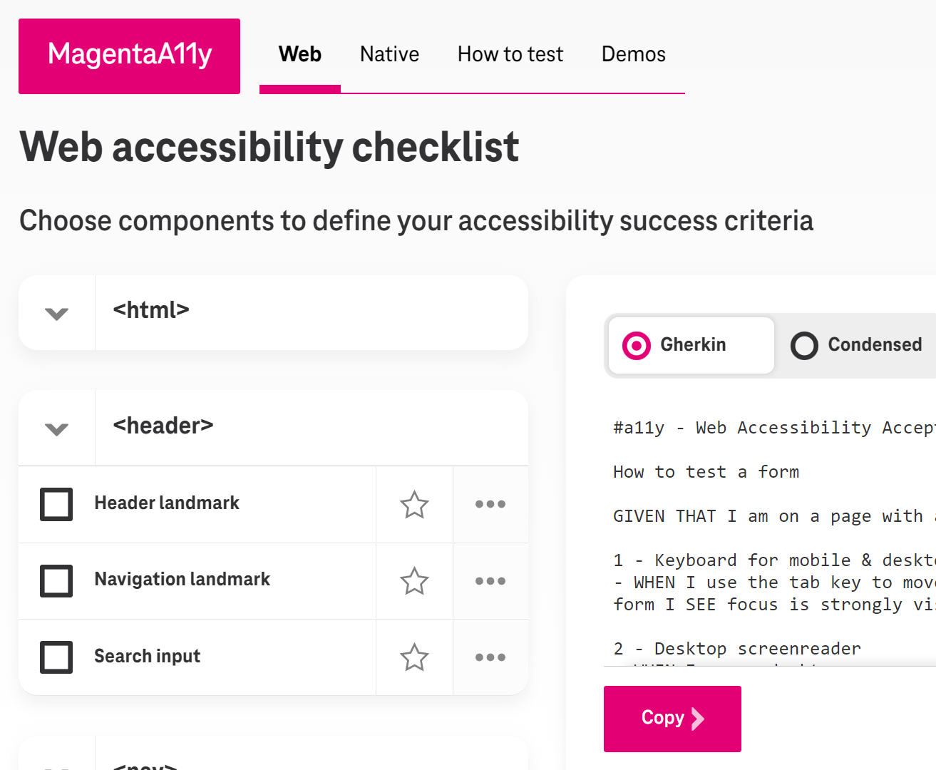

Shifting left
Notes:
“Shifting left” is about considering accessibility as early as possible in the development process. Here’s two really useful resources. If you are working with developers it can be useful to include accessibility within your definition of done, or to use behaviour driven development techniques to ensure your requirements are met. Magentally from T-mobile provides testing criteria in Gherkin format, which is often used for user stories and in behaviour driven development.
If you are buying a commercial off the shelf service, then this Accessible IT Procurement guide is vital. It has examples of legal clauses you can use during procurement, questions to ask and so on, and it’s aimed specifically at Higher Education.

Slide 42
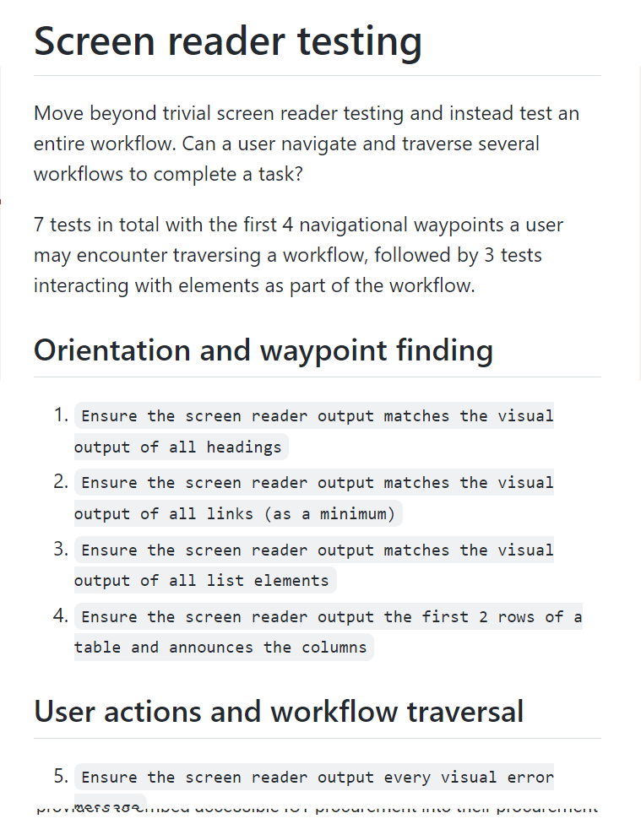
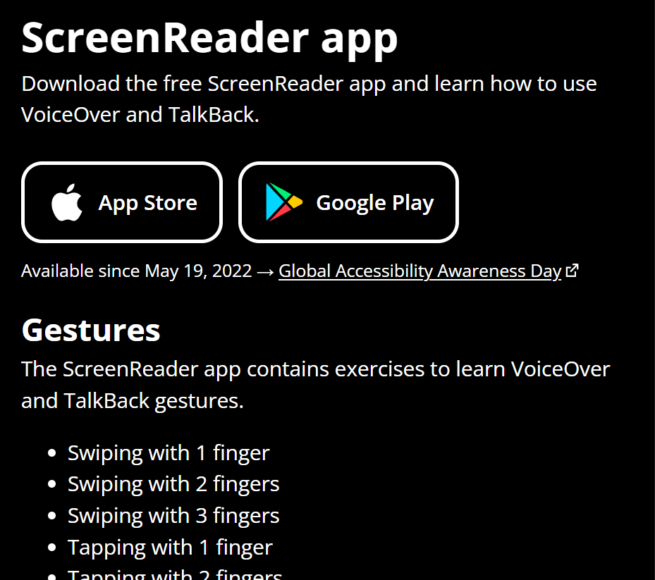
Testing
Notes:
Ideally we involve those who use assistive technologies such as screen readers to test our new sites and services, or changes to existing sites and services. This might not always be possible. If you need to do some screen reader testing yourself and aren’t sure how to start, Canaxxes has a screen reader testing guide and the ScreenReader app, developed by the Appt foundation who were on one of the lunch and learn sessions yesterday, is an app to help you to learn how to use a screen reader on a mobile device.

Slide 43
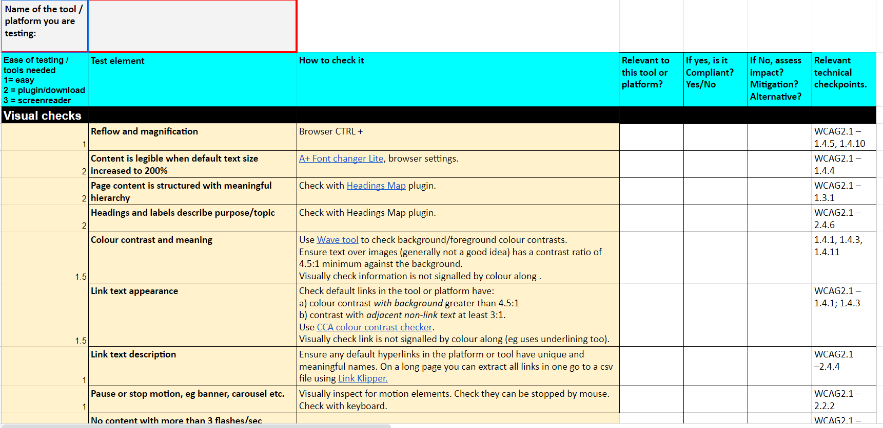
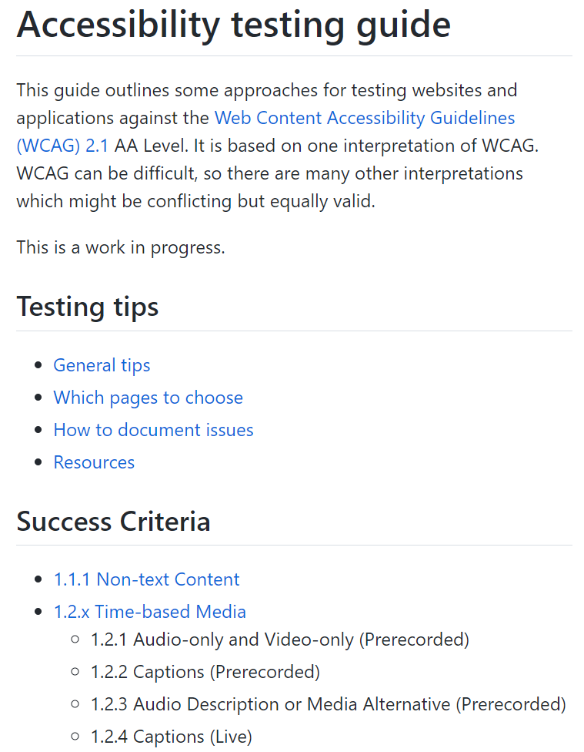
Testing 2
Notes:
On the topic of testing, Alistair McNaught has shared a really useful Tools and platforms Quick Check accessibility testing spreadsheet. If you need to do more deeper testing the Government Digital Service has a really useful accessibility testing guide. Of course there’s tools like Accessibility Insights but I assume everyone knows about that one.

Slide 44
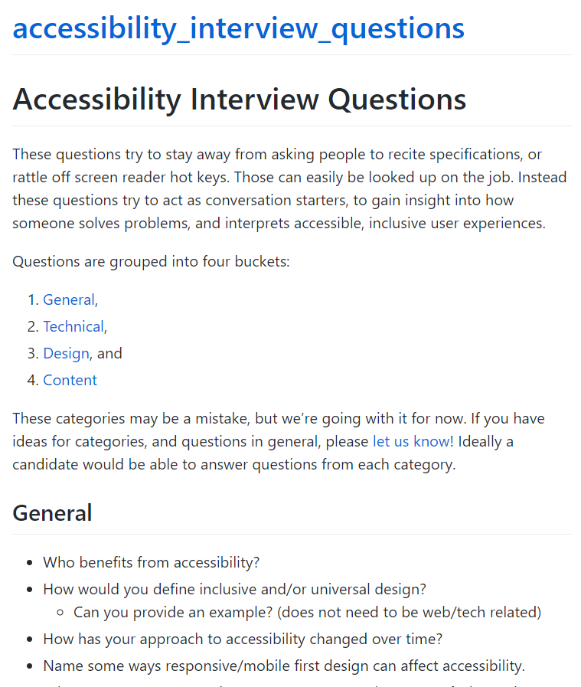
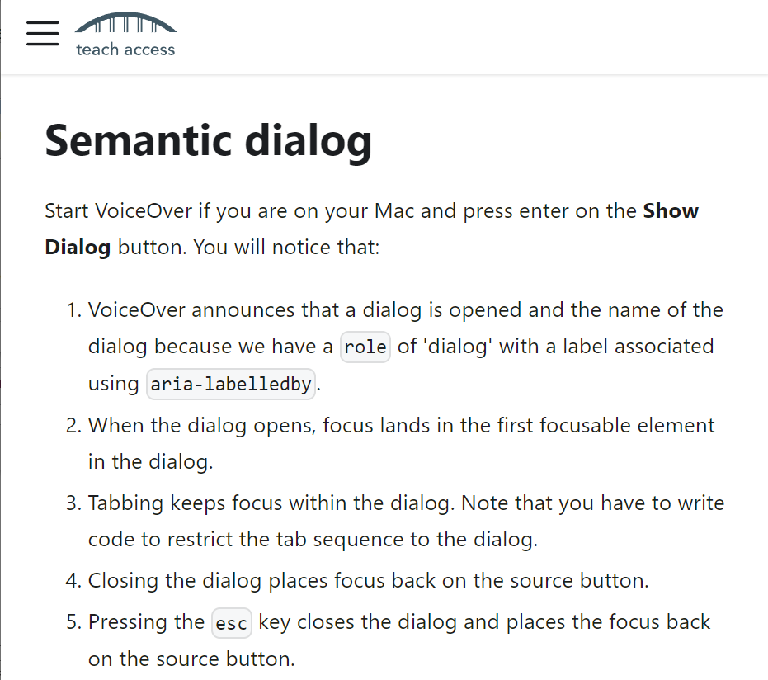
Developing staff
Notes:
And if you want to build or train your team Scott o Hara’s accessibility interview questions give some great examples of questions you could ask at interviews, and Teach Access offers an interactive accessibility tutorial for developers and designers.

Slide 45

Newsletters and blogs
Notes:
My recommended way to learn about accessibility and keep up to date is through accessibility news letters and blogs. As Charlie said in the Accessibility Champions session, community knowledge is really important. I’ve learnt the most from amazing blogs by people like Adrian Roselli, Eric Eggert, Sara Soueidan, Scott O Hara and especially Laura Carlson’s weekly newsletter. I’ve collated a list of my favourite accessibility news letters and blogs on my website.

Slide 46
Discussion
Notes:
Thanks for joining me on the lunch and learn. I hope there was something of use to everyone! A special thank you to our captioner Jen, and Tim and our Bridget BSL interpreter.
We can use the remaining time to try to answer any questions. Perhaps you’d like to look in more detail at something I shared? Or maybe you want to share how you approached demystifying, simplifying and amplifying accessibility at your organisation?
Before I start reviewing the slido, the next session at 14:00 is Innovation and Accessibility Eco Systems which looks amazing, and DO NOT MISS the session at 16:15, “User-generated accessibility information” with the lengendary Cam Beaudoin.

